Slide 1


Apache Spark and Mllib
Preformed by: Amir Amemi
Houcem Gharbi
Notes:
Good Morning, I appreciate your valuable time today, I present my project on Apache Spark and MLlib.

Slide 2
Table of contents
01
02
Apache Spark Overview
MLlib Introduction
03
Working with MLlib
04
Conclusion
Notes:
So, our Table of contents was devided into 5 main parts , What it is Apache Spark , What it is Mllib and the value added , a Small example of how Mllib work and we close with the Conclusion

Slide 3
Apache Spark Overview
01
What is Apache Spark?
Why Apache Spark ?
Apache Spark Components

Slide 4
What is Apache Spark?

Slide 5
What is Apache Spark ?
Open Source
Fast
MapReduce
Big Data
O
F
Freely available for anyone to download and use.
Utilizes in-memory caching for intermediate data storage
M
B
Supports
batch processing
Big + Data
Ingest and clean large datasets

Slide 6
Why Apache Spark?

Slide 7
Why Apache Spark ?
Efficiency
Versatility
Performance
Community
Fast, Distributed Data Processing Framework
Versatile and Unified Platform
In-Memory Computing for High Performance
Ongoing development and resources from a vibrant community

Slide 8
Apache Spark Components

Slide 9
Apache Spark Components
2012
2013
2014
2014
Spark Streaming
MLlib
Spark SQL
GraphX
Processes real-time data streams using micro-batch processing
A rich library for scalable machine learning tasks
Allows querying structured data using SQL within Spark applications
A graph processing library for analyzing graph-structured data
Notes:
On 2012 Apache Spark Lance spark Streaming …

Slide 10
Mllib Introduction
02
Introduction to Mllib
MLlib Components
Why MLlib?

Slide 11
Introduction to Mllib

Slide 12
Definition
MLlib, short for Machine Learning Library, is Apache Spark's dedicated library for machine learning tasks. It is designed to simplify and accelerate the development of scalable and distributed machine learning applications within the Spark framework
Notes:
MLlib's role in scalable and distributed machine learning aligns with Spark's overall goal of providing a unified platform for diverse data processing workloads. It empowers data scientists and developers to apply machine learning algorithms to large datasets with the efficiency and parallelization capabilities offered by Spark.

Slide 13
MLlib Components

Slide 14
MLlib Components
Classification
Regression
Clustering
Collaborative Filtering
C
R
Involves categorizing data points into predefined classes or labels
Predicts a continuous outcome based on input features
C
C
Groups similar data points into clusters based on inherent patterns
Recommends items or content based on the preferences and behaviors of similar users

Slide 15
Why MLlib?

Slide 16
Integration
Scalability
MLlib seamlessly integrates with Spark's ecosystem, including Spark Core, Spark SQL, and Spark Streaming
MLlib is designed to scale horizontally, enabling the processing of large datasets across a distributed computing cluster

Slide 17
Working with MLlib
03

Slide 18
Small Example with MLlib (Python Code)

Slide 19
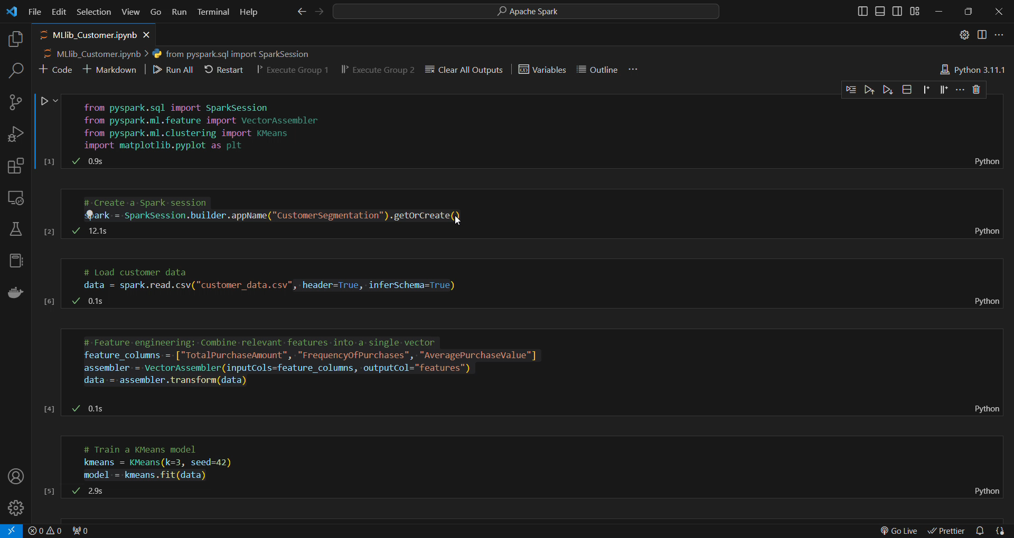

Code Demo
This code demonstrates the use of Apache Spark's MLlib for customer segmentation using the KMeans clustering algorithm.

Slide 20
Conclusion
04

Slide 21
Conclusion
04

Slide 22
Conclusion
MLlib
Efflexibility
Apache Spark
Through a small example employing MLlib (Python Code), we've demonstrated its simplicity and efficiency, especially evident in tasks such as KMeans clustering
Apache Spark stands out as a fast and distributed data processing framework
MLlib emerges as a fundamental component, dedicated to machine learning tasks within Apache Spark

Slide 23
THANK YOU !

